Slide 1
Module Regular Expressions
Module Regular Expressions(RE) specifies a set of strings(pattern) that matches it.
MetaCharacters are useful, important and will be used in functions of module re.
Python has a module named re to work with regular expressions. To use it, we need to import the module.
import re
The module defines several functions and constants to work with RegEx.
There are a total of 14 metacharacters and will be discussed as they follow into functions:

Slide 2
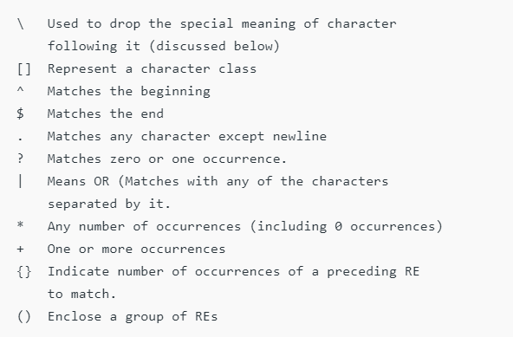

Slide 3
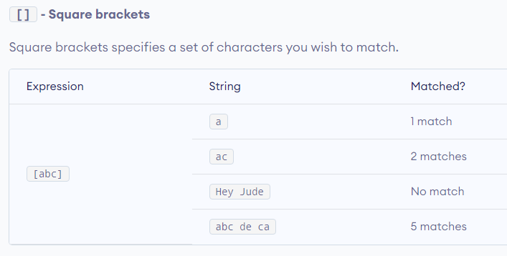

Slide 4
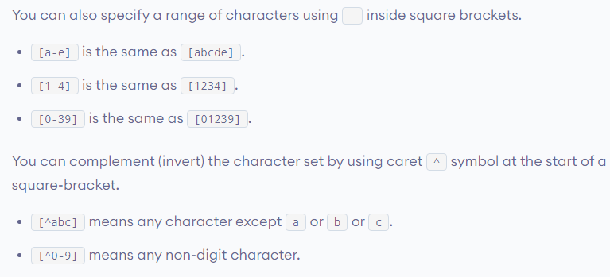

Slide 5
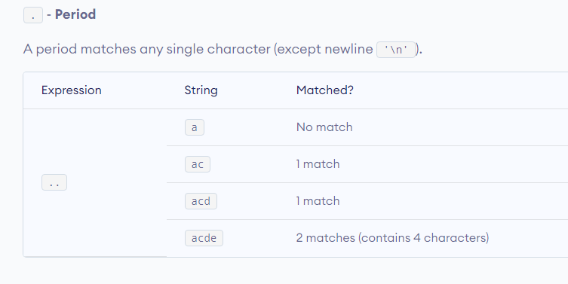

Slide 6
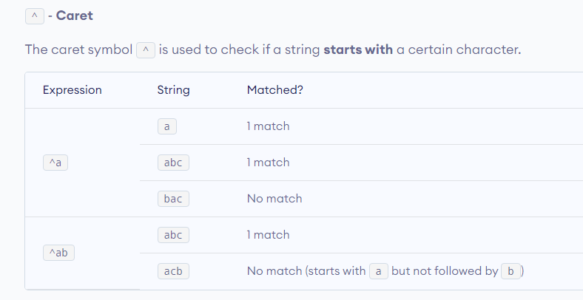

Slide 7
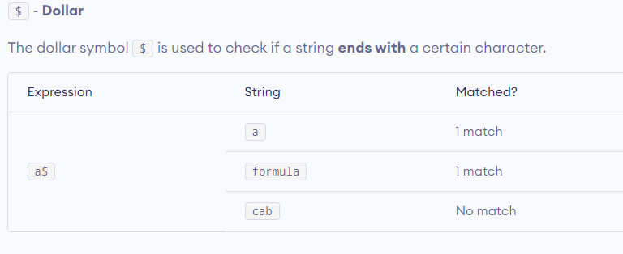

Slide 8
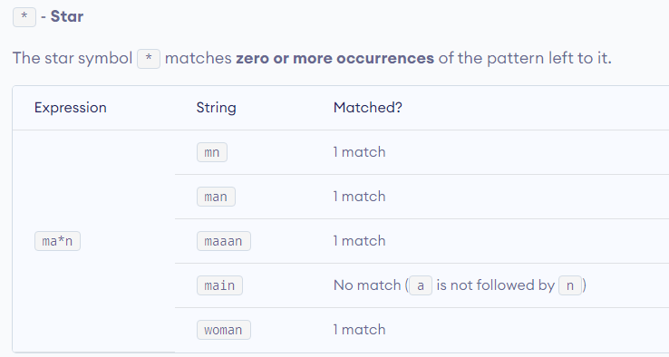

Slide 9
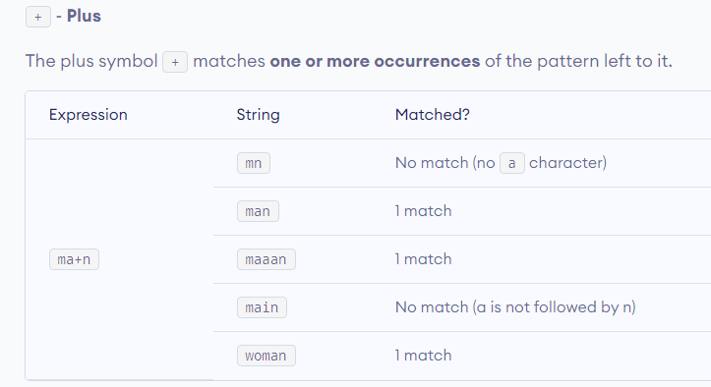

Slide 10
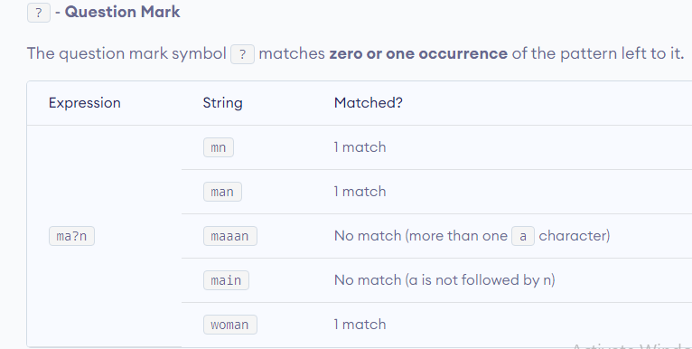

Slide 11
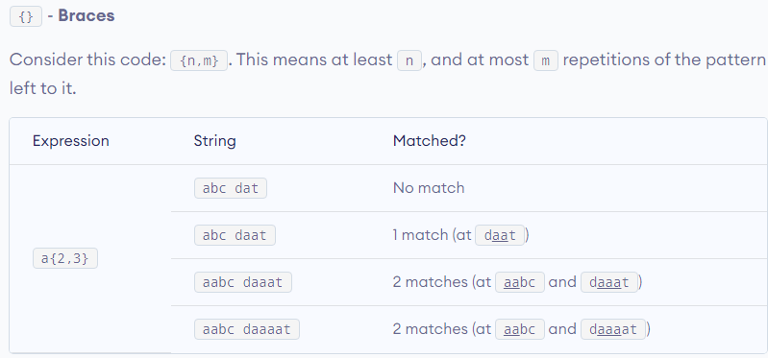

Slide 12
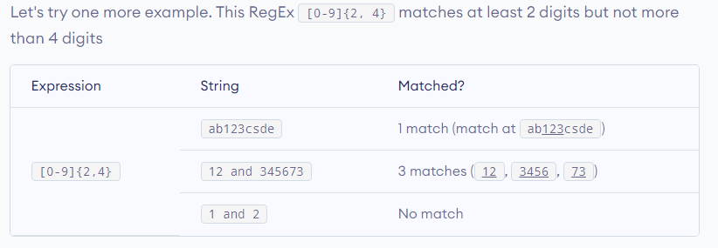

Slide 13
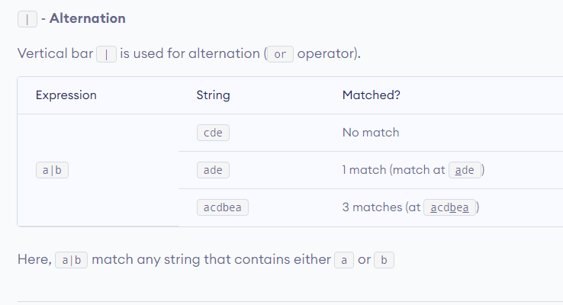

Slide 14
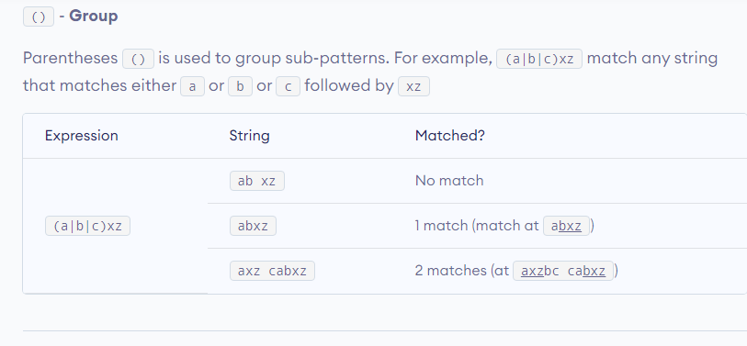

Slide 15
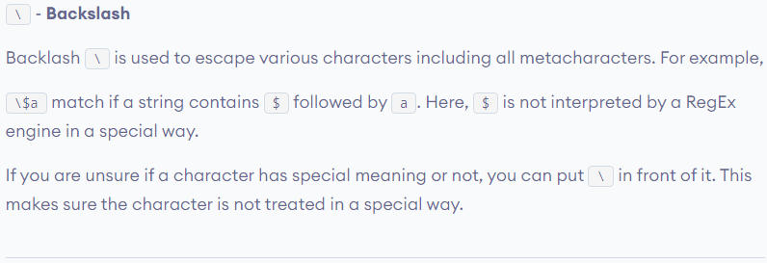

Slide 16
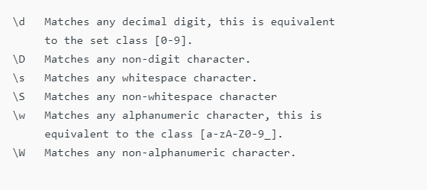

Slide 17
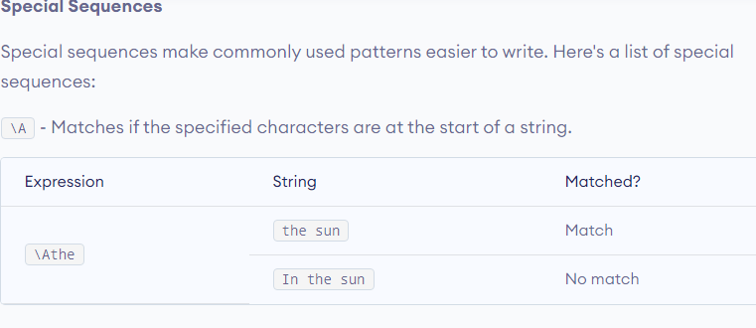

Slide 18
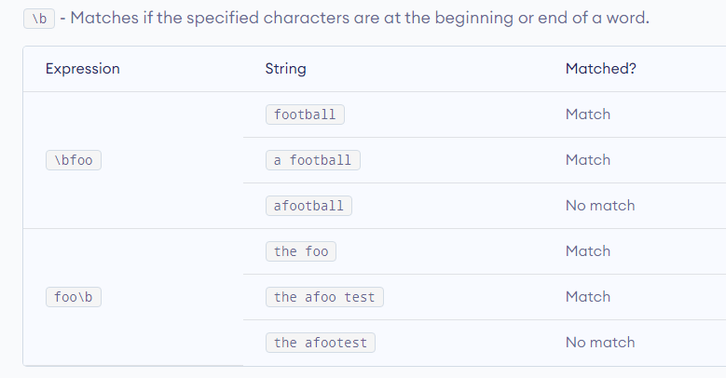

Slide 19
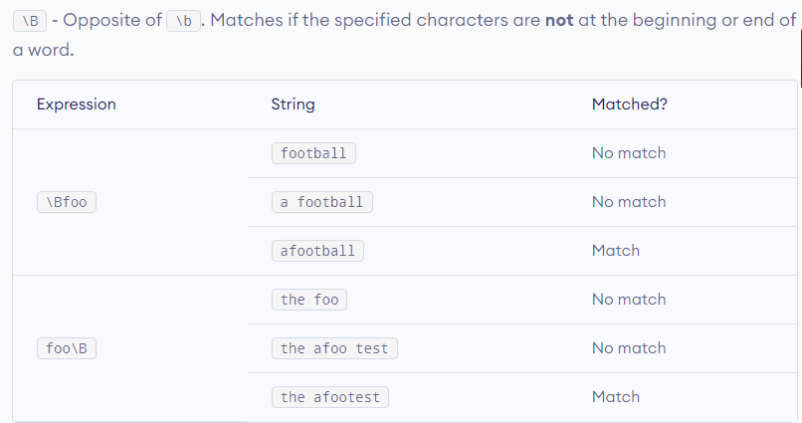

Slide 20
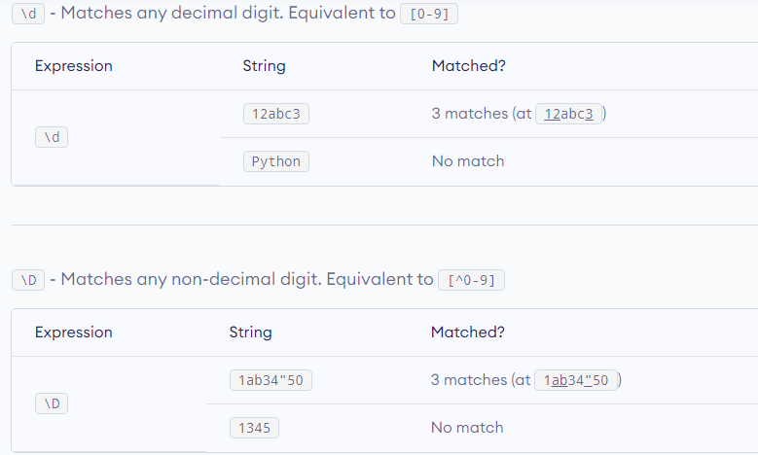

Slide 21
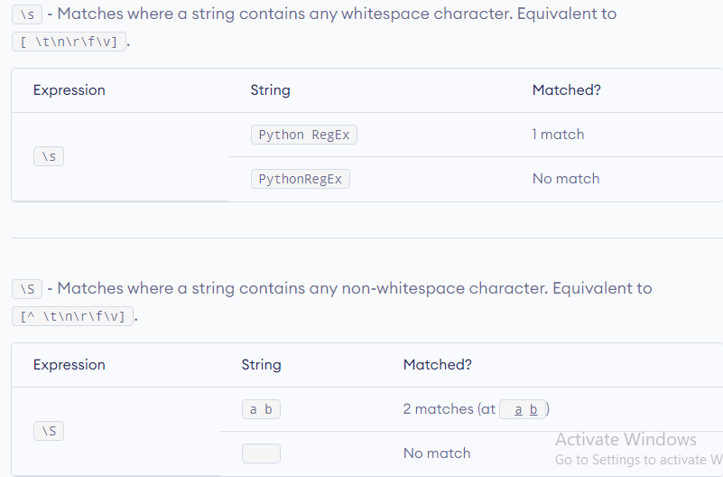

Slide 22
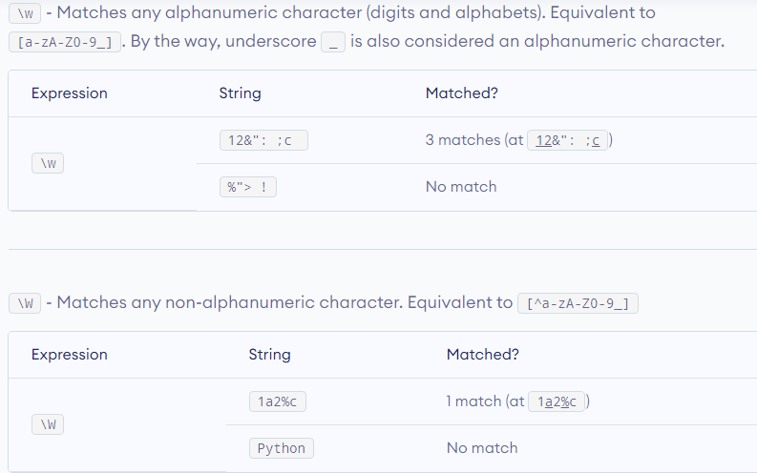

Slide 23
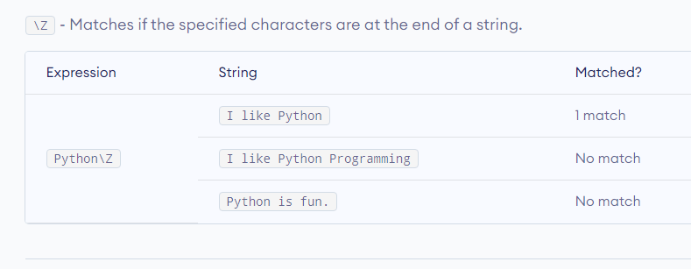

Slide 24
Function compile()
Regular expressions are compiled into pattern objects, which have methods for various operations such as searching for pattern matches or performing string substitutions.
Function split() Split string by the occurrences of a character or a pattern, upon finding that pattern, the remaining characters from the string are returned as part of the resulting list. Syntax :re.split(pattern, string, maxsplit=0, flags=0)
Function sub()
re.sub(pattern, repl, string, count=0, flags=0)
The ‘sub’ in the function stands for SubString, a certain regular expression pattern is searched in the given string(3rd parameter), and upon finding the substring pattern is replaced by repl(2nd parameter), count checks and maintains the number of times this occurs.

Slide 25
Function subn()
re.subn(pattern, repl, string, count=0, flags=0)
subn() is similar to sub() in all ways, except in its way to providing output. It returns a tuple with count of total of replacement and the new string rather than just the string.
Function escape()
re.escape(string)
Return string with all non-alphanumerics backslashed, this is useful if you want to match an arbitrary literal string that may have regular expression metacharacters in it.

Slide 26
re.search()
This method either returns None (if the pattern doesn’t match), or a re.MatchObject that contains information about the matching part of the string. This method stops after the first match, so this is best suited for testing a regular expression more than extracting data.
re.match()
This function attempts to match pattern to whole string. The re.match function returns a match object on success, None on failure.
You can get methods and attributes of a match object using dir() function.
Some of the commonly used methods and attributes of match objects are: match.group() The group() method returns the part of the string where there is a match.
re.findall()
Return all non-overlapping matches of pattern in string, as a list of strings. The string is scanned left-to-right, and matches are returned in the order found

Slide 27
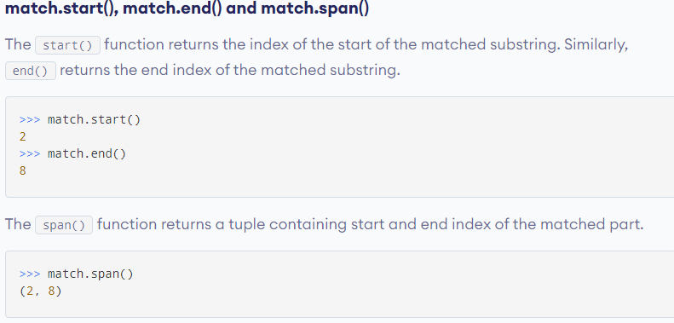

Slide 28
re.search() VS re.findall()
re.search()
re.search() method either returns None (if the pattern doesn’t match), or a re.MatchObject that contains information about the matching part of the string. This method stops after the first match, so this is best suited for testing a regular expression more than extracting data.
re.findall()
Return all non-overlapping matches of pattern in string, as a list of strings. The string is scanned left-to-right, and matches are returned in the order found.

Slide 29
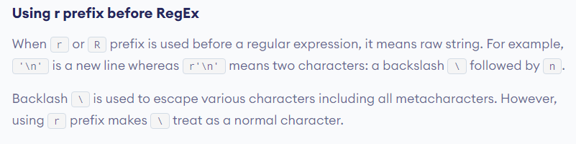

Slide 30
re.VERBOSE : This flag allows you to write regular expressions that look nicer and are more readable by allowing you to visually separate logical sections of the pattern and add comments.
Whitespace within the pattern is ignored, except when in a character class, or when preceded by an unescaped backslash, or within tokens like *?, (?: or (?P. When a line contains a # that is not in a character class and is not preceded by an unescaped backslash, all characters from the leftmost such # through the end of the line are ignored.

Slide 31
Let’s take a password as a combination of alphanumeric characters along with special characters, and check whether the password is valid or not with the help of few conditions.
Conditions for a valid password are:
Should have at least one number.
Should have at least one uppercase and one lowercase character.
Should have at least one special symbol.
Should be between 6 to 20 characters long.

